Slide 1
ENEE459D - Final Project
Allen Onyegbado, Abbas Paryavi

Slide 2
Objective
Create a simplified MIPS processor
A more simplified version of the MIPS processor
Have two of these MIPS processors on a dual core CPU
Implement on a FPGA board and have it toggle between the processors

Slide 3
All Modules
topmodule
systembus
extememory
mux21
Sevseg
mips (x2)
controller
alucontroller
pccontroller
mux21
datapath2
Regfile
Alu
mux21 (x4)
mux41

Slide 4
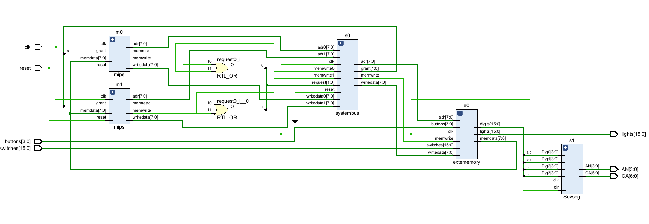
Top Module Schematic

Slide 5
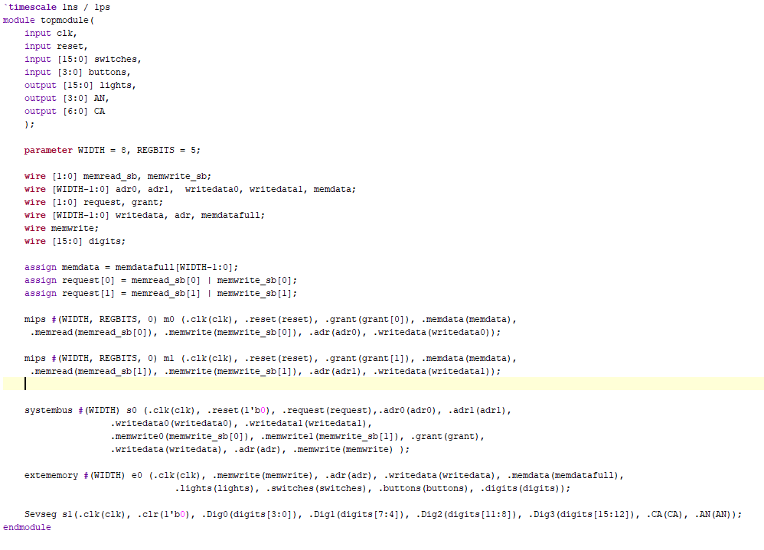
Top module
code

Slide 6
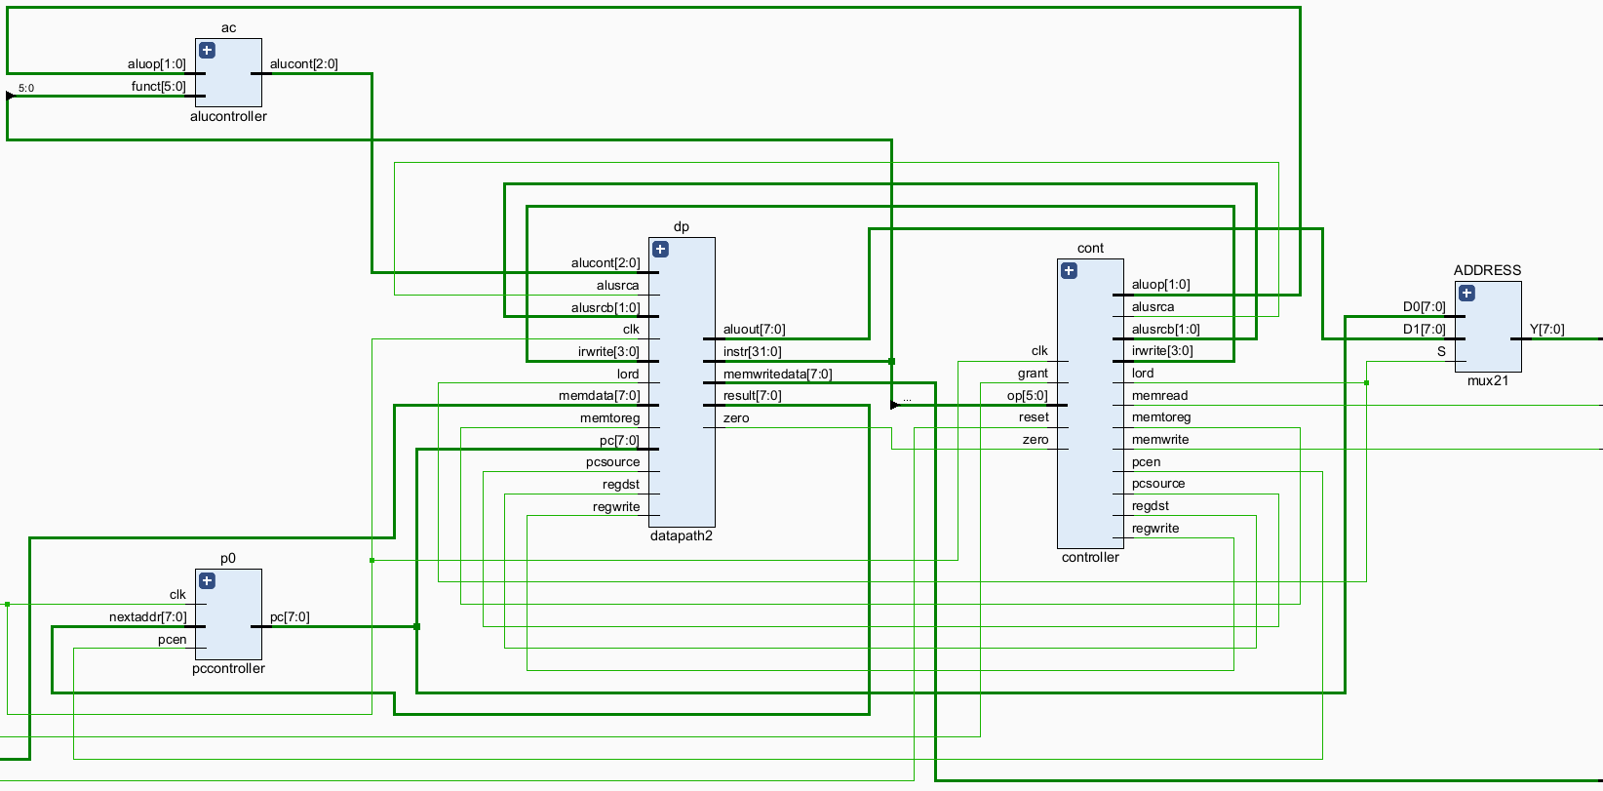
Mips Schematic

Slide 7
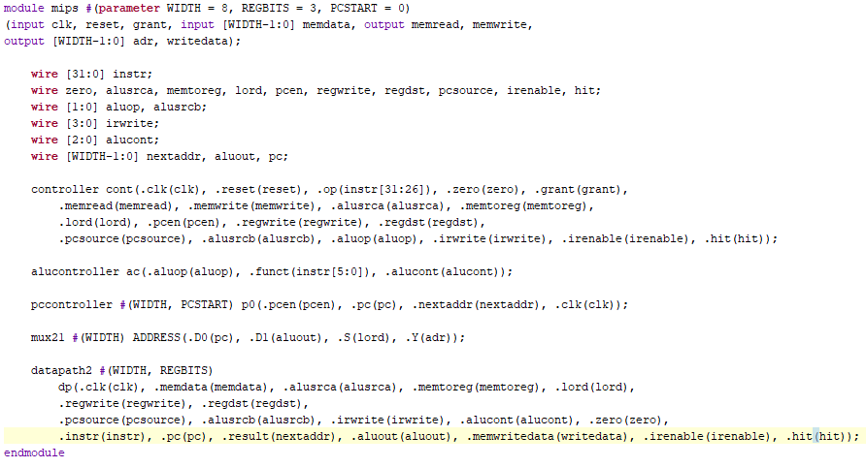
Mips

Slide 8
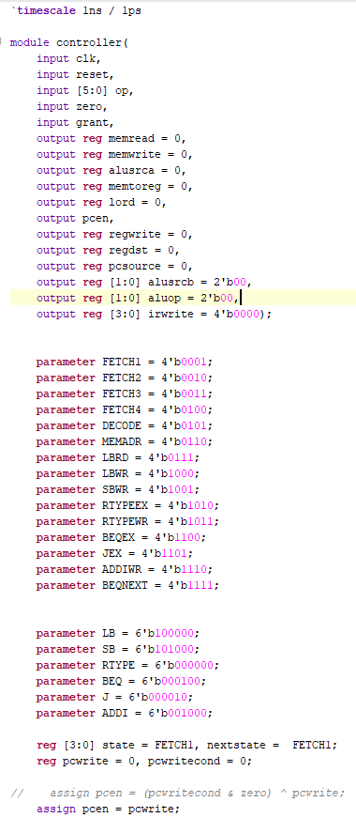
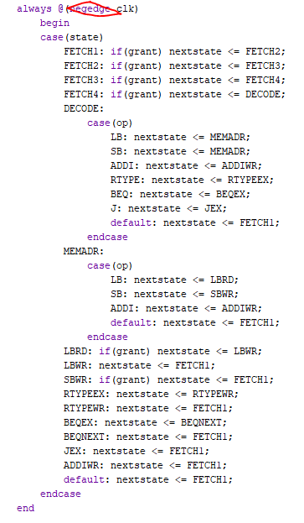
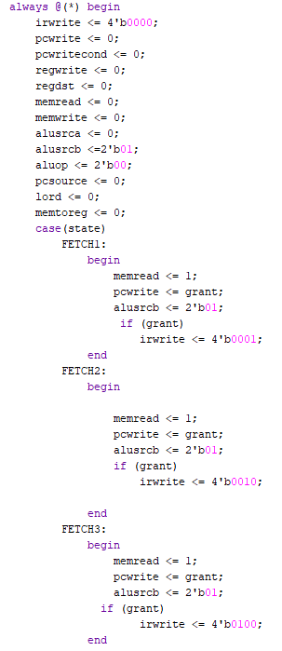
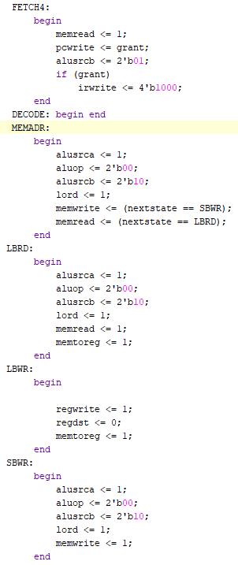
Controller

Slide 9
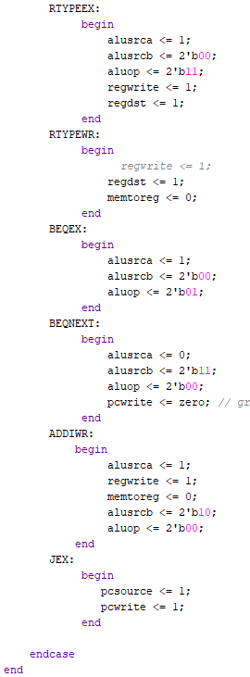
Controller 2
BEQEX - does subtraction between rs and rt
New State: BEQNEXT - takes branch if previous result was zero
A few signals held high between states to ensure correct sampling.
Non buffered ALU output meant memory accessing states (LBRD, SBWR) needed to have the same inputs to the ALU to correctly capture the correct
Some signals needed to be set high before the state that they were actually used in

Slide 10
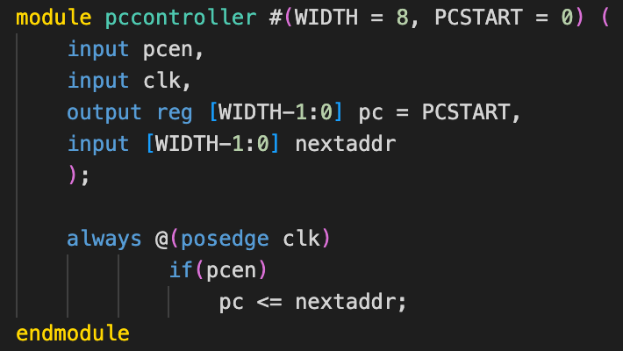
PC controller

Slide 11
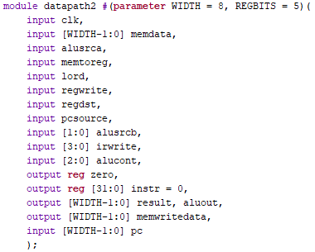
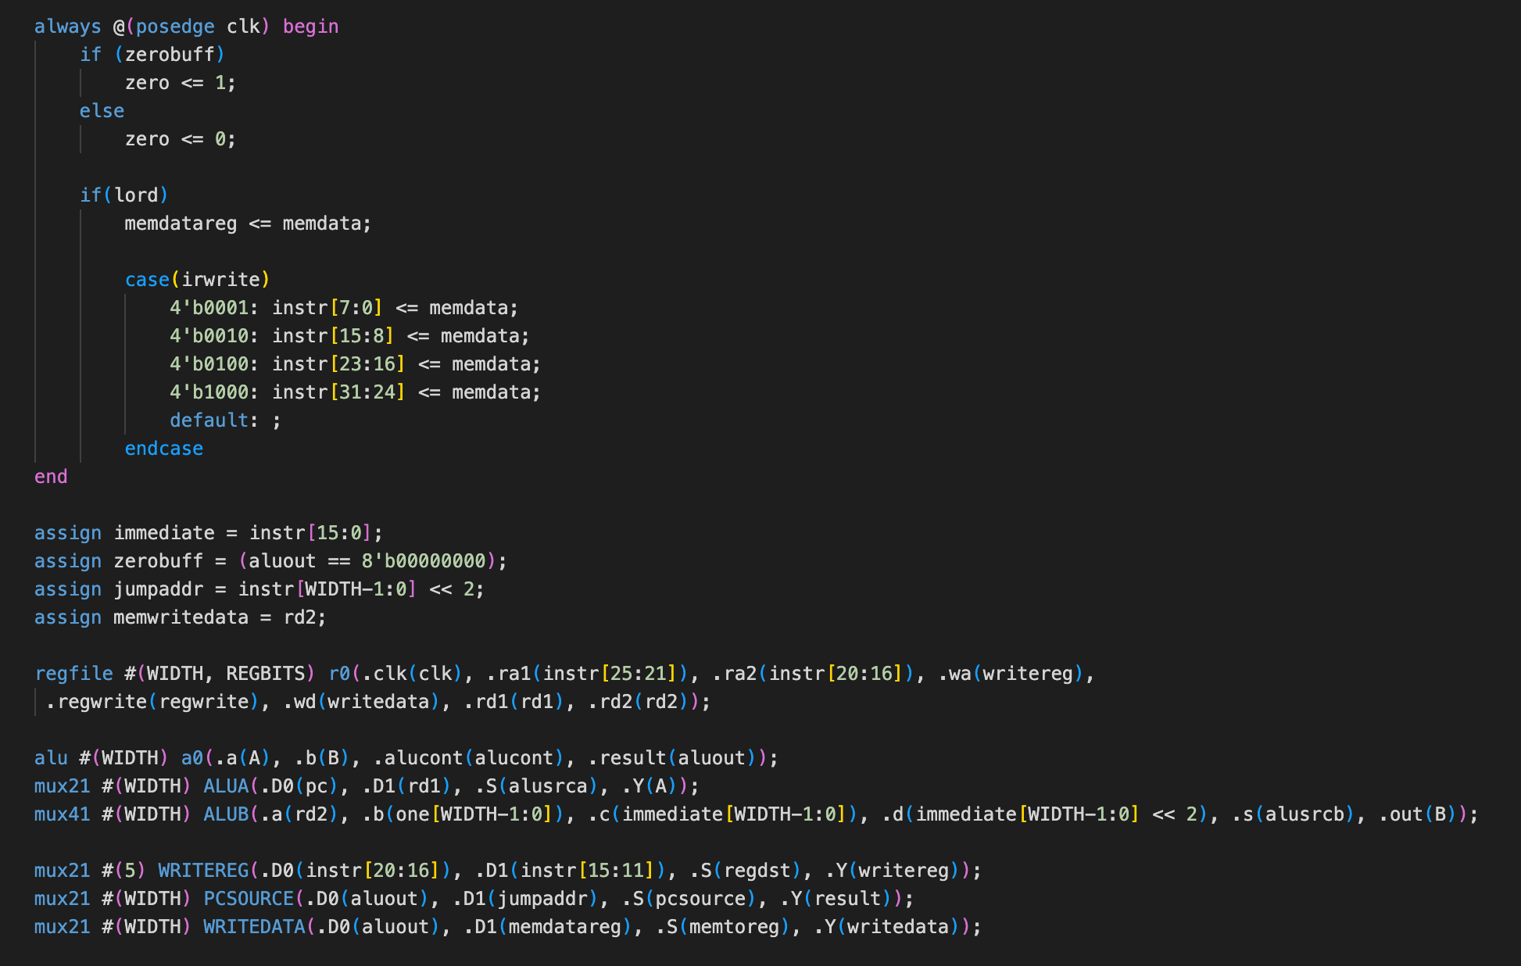
Datapath
zerobuff: saves previous zero result from ALU for use in BEQ/SB/LB instructions
memdatareg: saves previous result from ALU to be written into memory

Slide 12
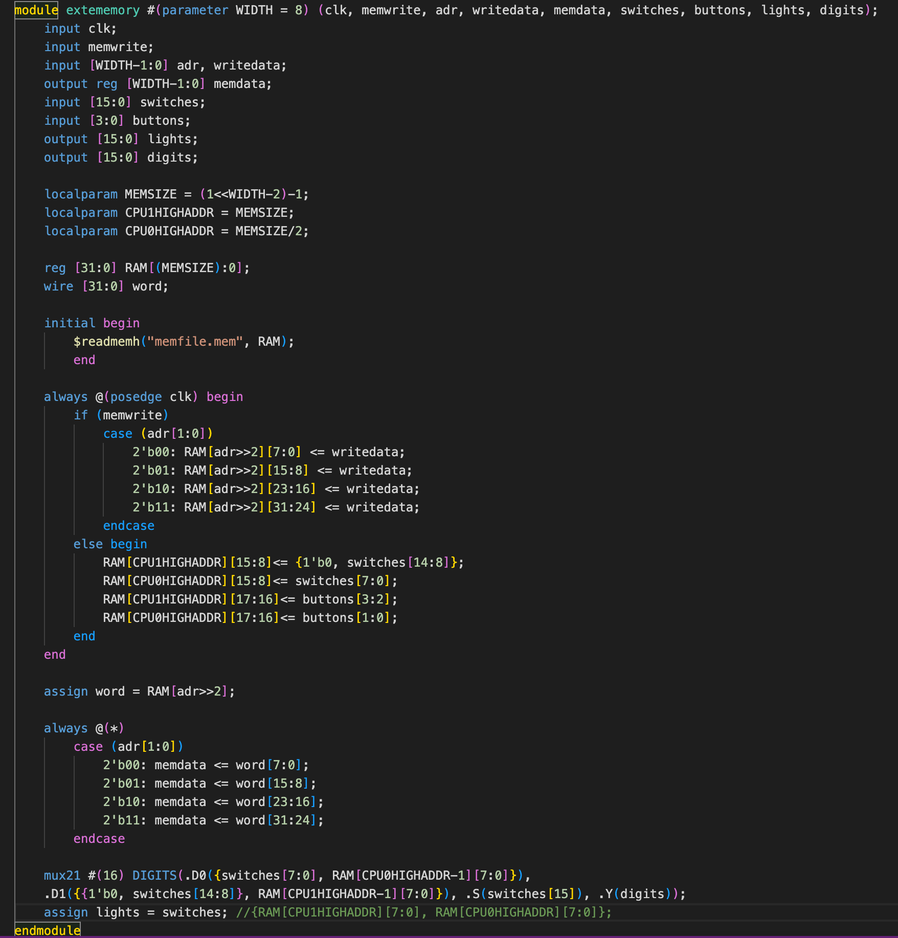
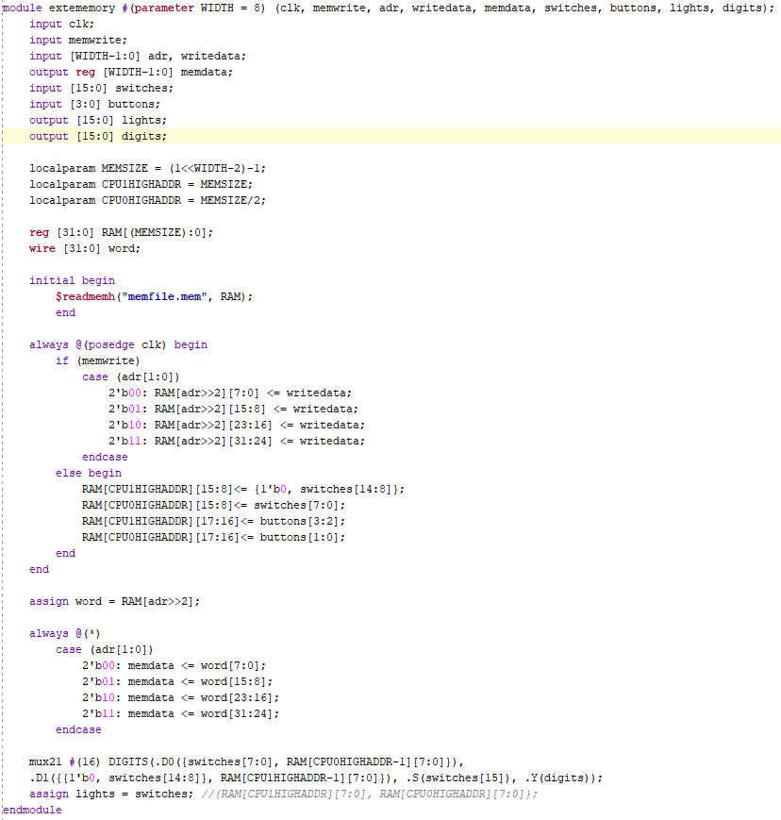
Memory/IO
256 bytes total
128 per core
Last 4 bytes used for switch and button input (for each core)
Next byte used for output to display (for each core)

Slide 13
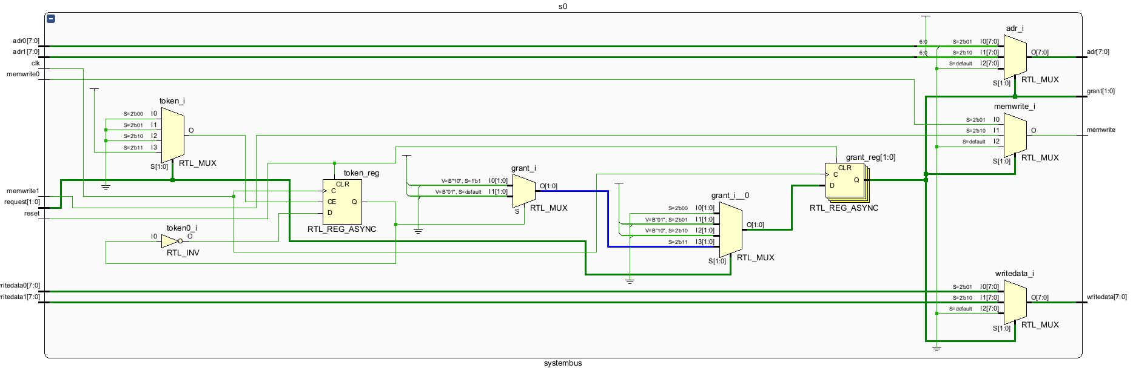
SystemBus Schematic

Slide 14
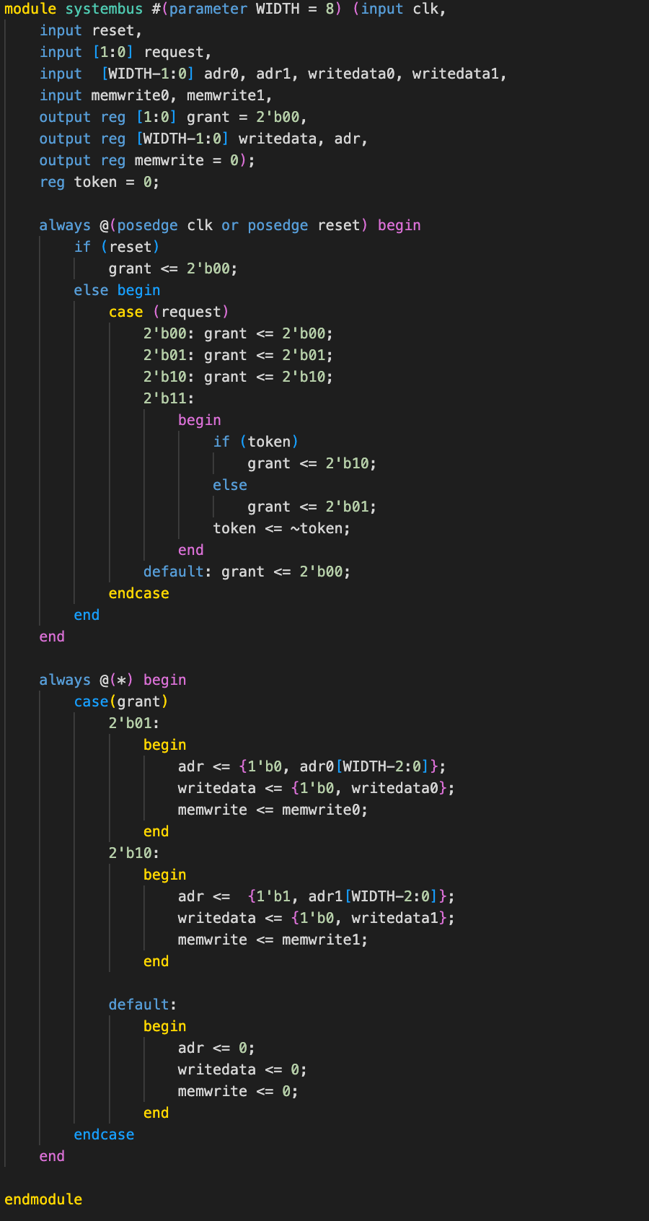
SystemBus Code

Slide 15
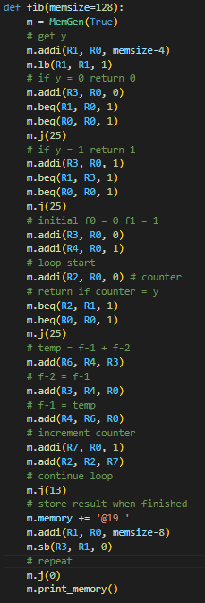
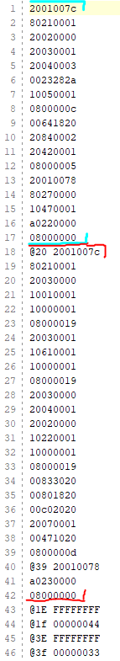
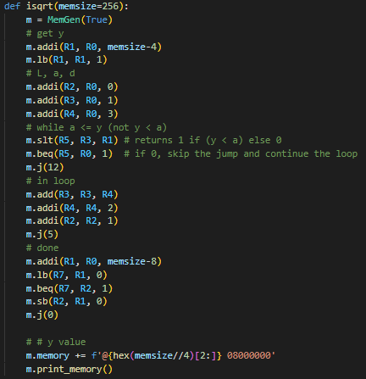
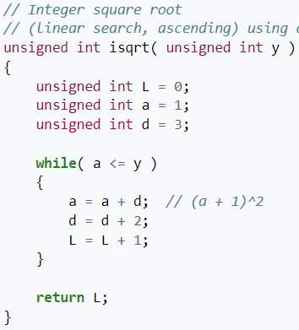
Program

Slide 16
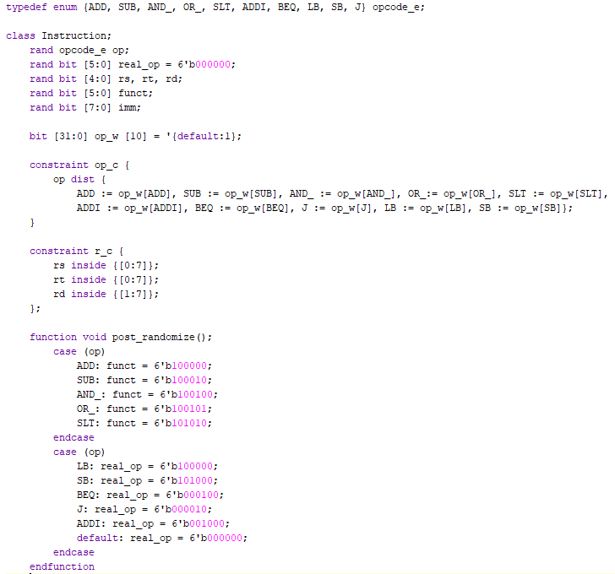
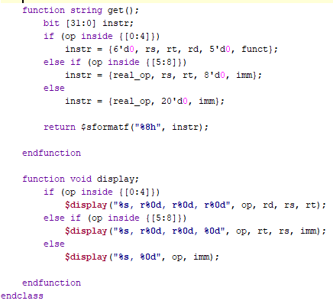
Testbench (In progress)

Slide 17
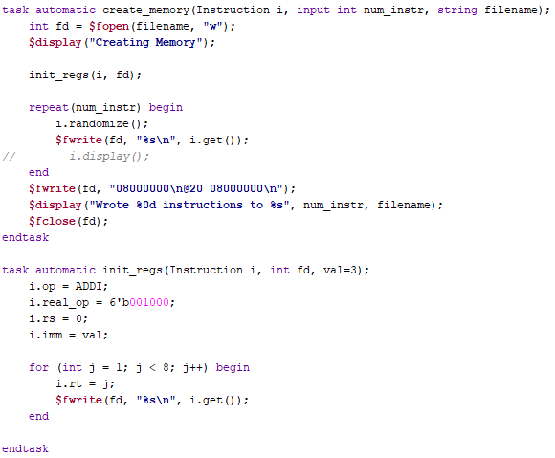
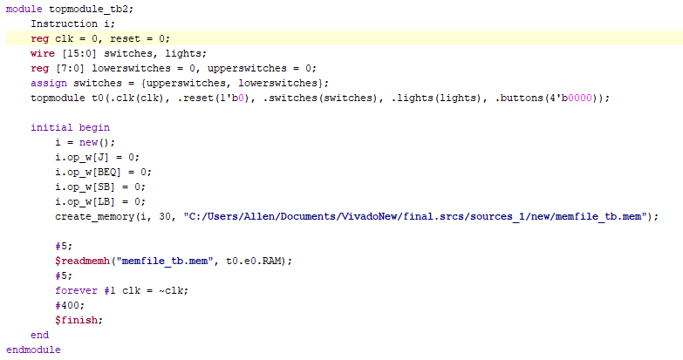
Testbench 2

Slide 18
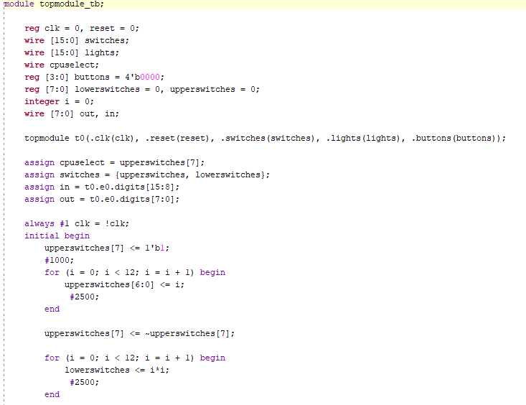
Simulation

Slide 19
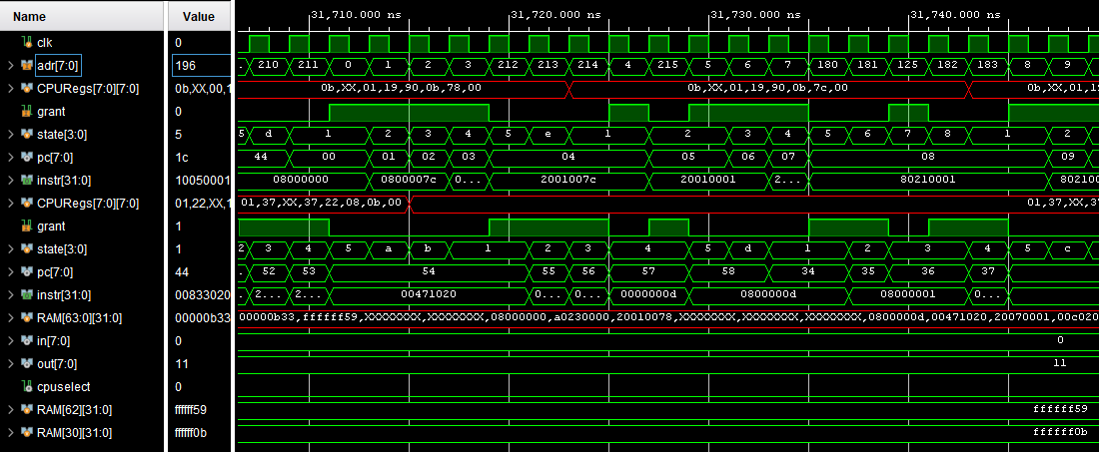
Simulation

Slide 20
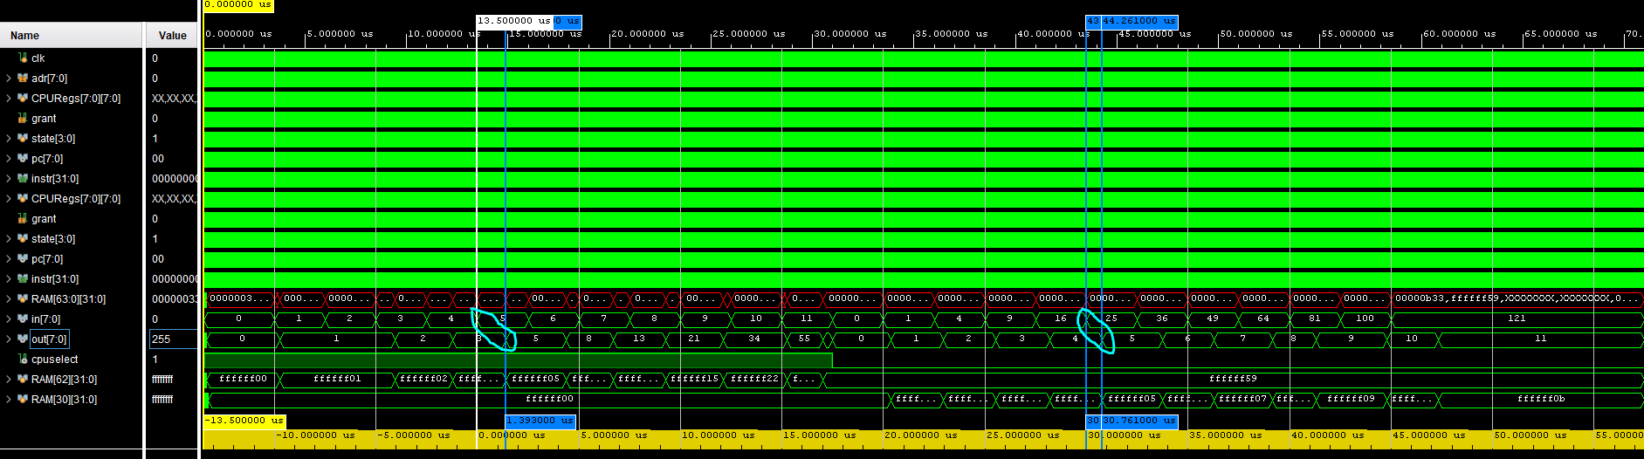
Simulation

Slide 21
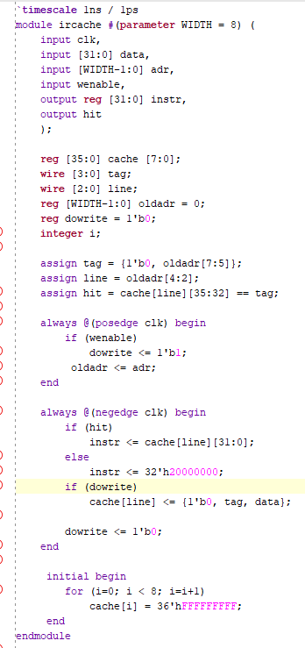
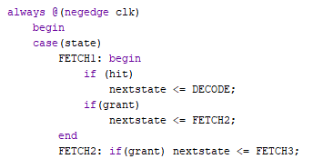
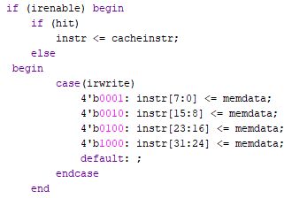
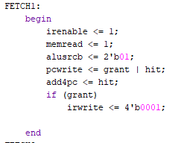


Instruction Cache

Slide 22
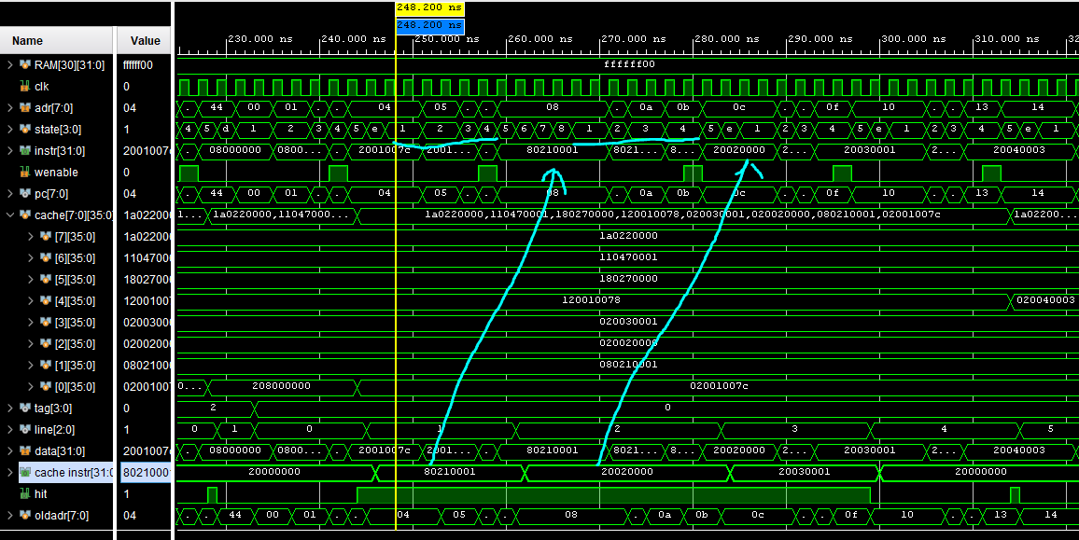
Instruction Cache

Slide 23
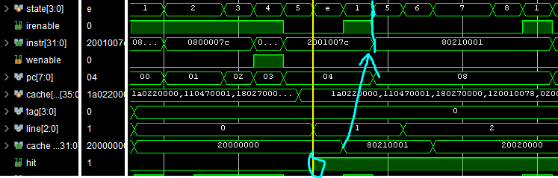
Instruction Cache

Slide 24
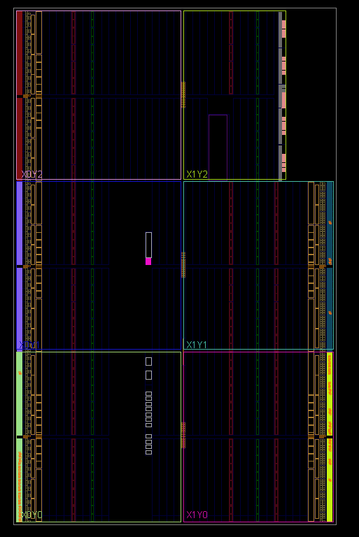
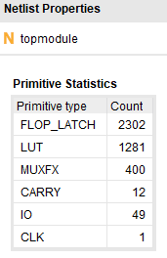

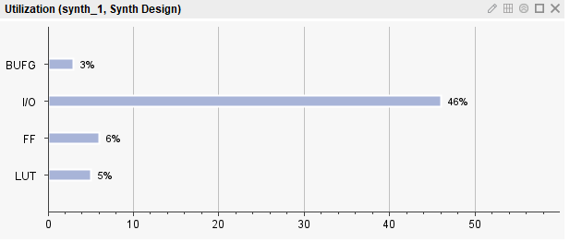
Synthesis Results

Slide 25
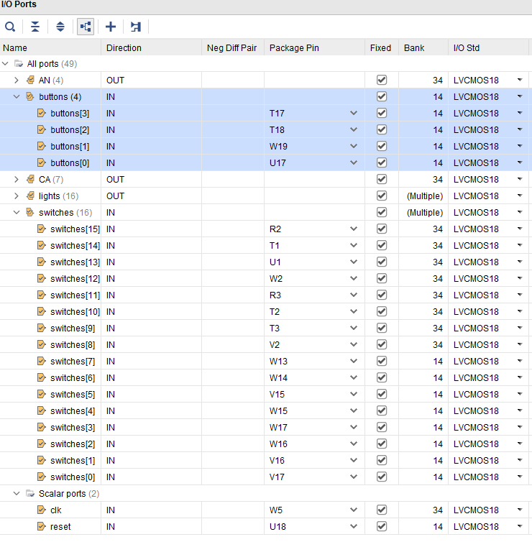
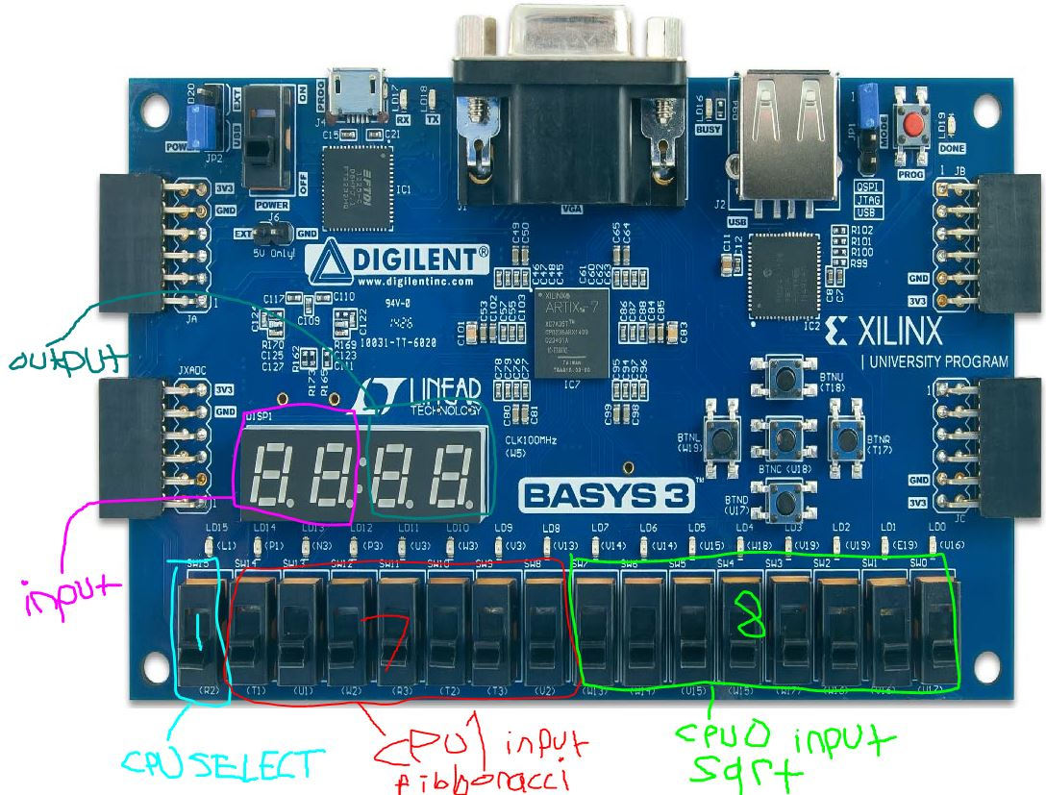
Board Layout

Slide 26
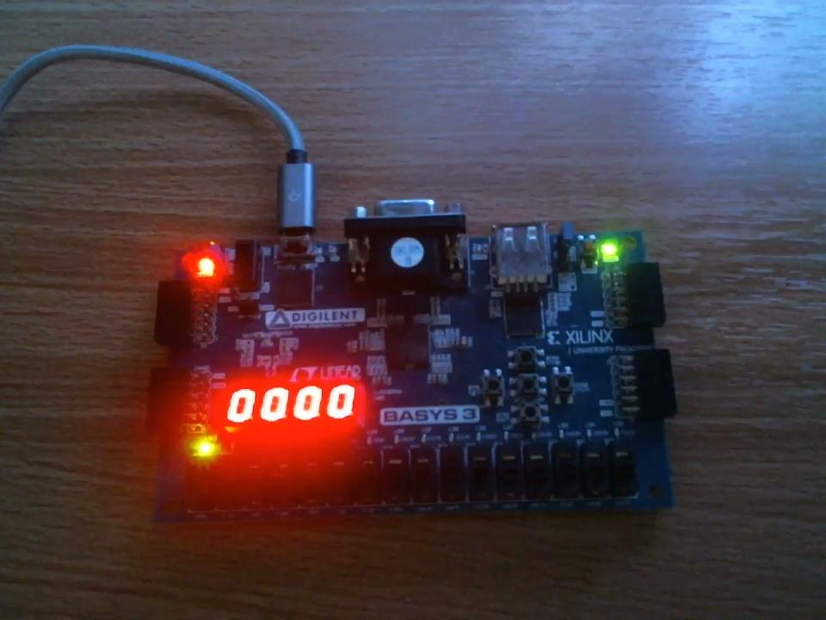
Demo

